Slide 1

TEAM NAME : “THE DATA DIGGERS”
ATTRITION DATASET ANALYSIS
EMPLOYEE TURNOVER
CS-513-A : Professor KHASHA DEHNAD

Slide 2





Malika Thakur
CS 513 A
CS
Graduate
Swati Shiriyannavar
CS 513 B
MIS
Graduate
Jayant Kumar
CS 513 A
CS
Graduate
Neil Sharma
CS 513 A
CS
Graduate

Slide 3

In today’s competitive job market, employee attrition is one of the most pressing issues businesses face.
Employee turnover is costly. Each time an employee leaves, they take a significant portion of their knowledge and expertise with them.
Therefore, We've developed a model using different classifiers that would help an organization predict employee turnover given some attributes and be pro-active in helping to solve such a costly matter.

Slide 4
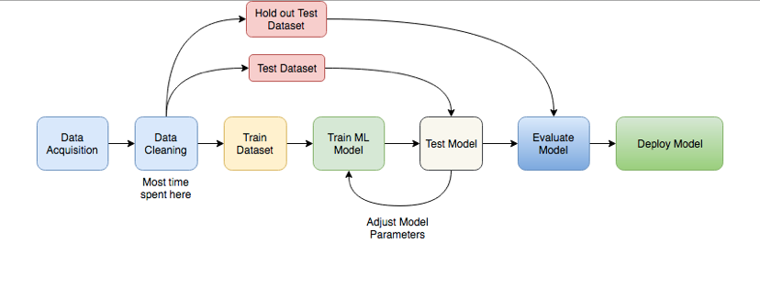
FLOW OF THE PROJECT

Slide 5
LIST OF ALGORITHMS USED
K - Nearest Neighbors
Gaussian Naïve Bayes
Random forest Classifier
Decision Tree Classifier
Artificial Neural Network
Support Vector Machines

Slide 6
VARIABLE DESCRIPTION
VARIABLE | DESCRIPTION
EMP_ID | The ID of the employee
ANNUAL_RATE | Salary of employee annually
HRLY_RATE | Salary of employee hourly
JOBCODE | Job code of particular department of employee
ETHNICITY | The ethnicity of employee (Asian, white, AMIND etc..)
SEX | Sex of employee (M/F)
MARITAL-STATUS | Marital status of the employee (S/M/D)
JOB_SATISFACTION | Job Satisfaction level (1-4)
AGE | Age of the employee
NUMBER_OF_TEAM_CHANGED | No of teams changed by the employee
REFERRAL-SOURCE | Joining source of referral
HIRE_MONTH | Hire month of the employee
VARIABLE | DESCRIPTION
REHIRE | If the employee is rehired by the company (T/F)
TERMINATION_YEAR | Termination year of the employee
IS_FIRST_JOB | If it’s the first job of the employee (Y/N)
TRAVELLED_REQUIRED | If travel is required for the employee
PERFORMANCE_RATING | Performance rating of employee
DISABLED_EMP | If the employee is disabled
DISABLED_VET | If the employee is a veteran and disabled
EDUCATION_LEVEL | Education level of employee(1-4)
STATUS | Status (Terminated/Active)
JOB_GROUP | Job group/department of employee
PREVYR_1 , PREVYR_2, PREVYR_3, PREVYR_4, PREVYR_5 | Performance rating for previous 5 years of the employee

Slide 7
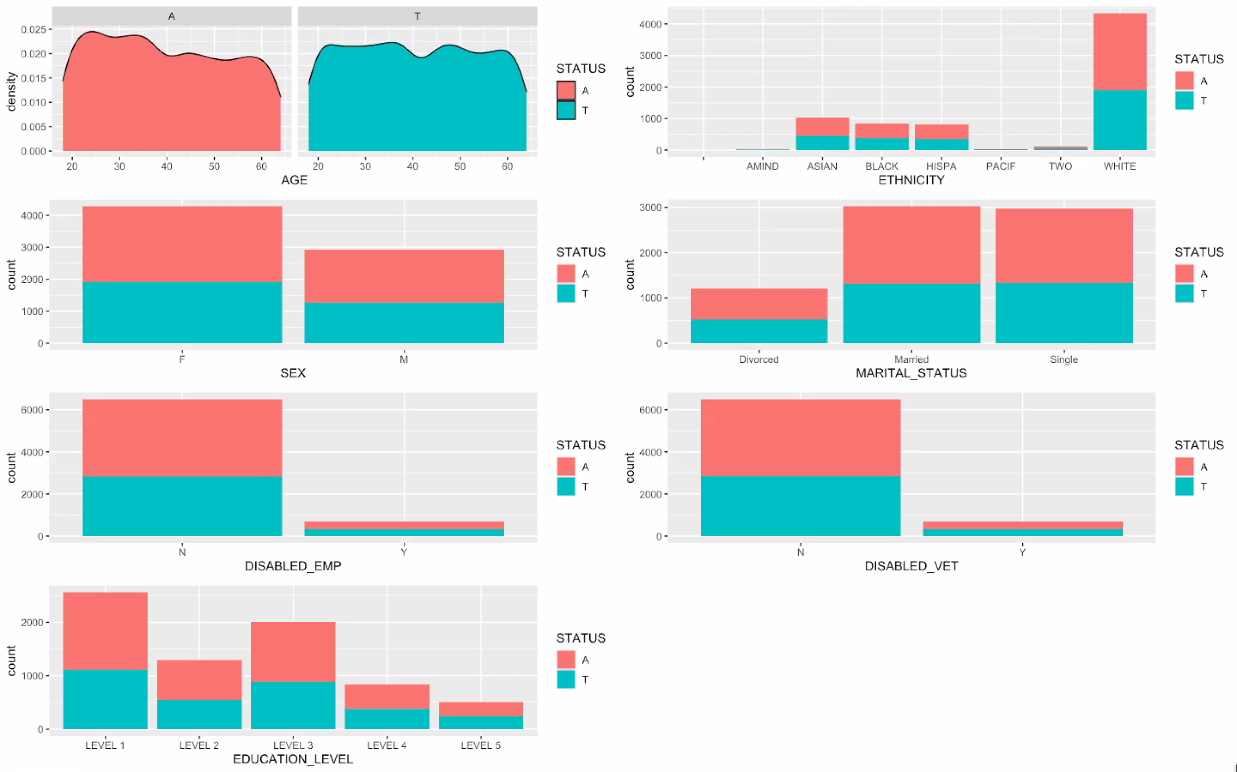
DATA ANALYSIS
Employee Personal Demographics - Numerical and categorical variables
Attrition rate is higher for:
Younger employees with 25-35 age group.
Female employees.
Disabled employees.
Employees with education level between 1-3.
White Employees.
Not divorced (Married/Single)
Not a disabled Veteran.

Slide 8
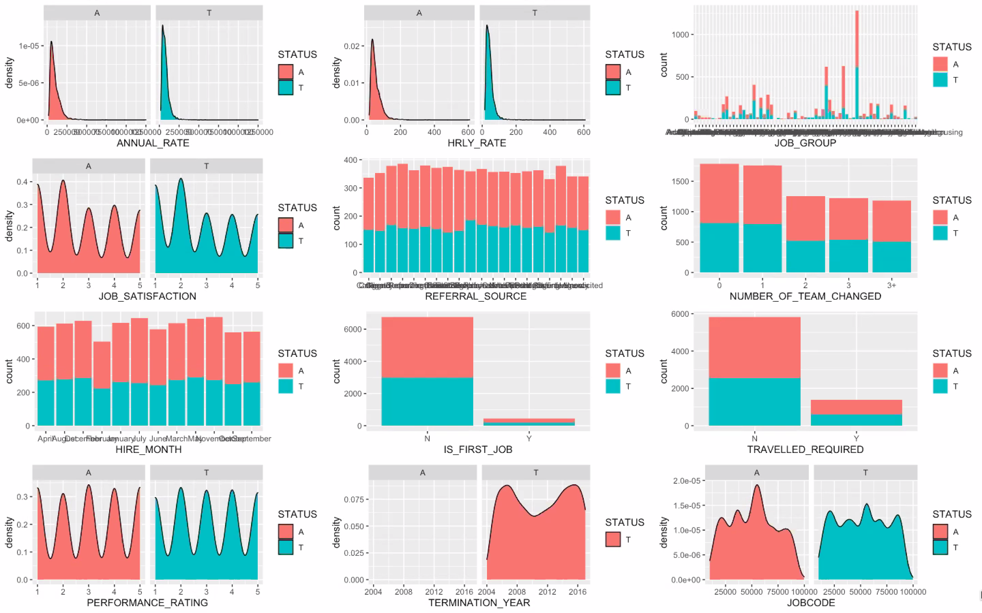
DATA ANALYSIS
Employee Work Demographics - Numerical and categorical variables
Attrition rate is higher for:
Employees with 1st Job.
Number of teams changed is < 2.
Travel required is minimal.
Employees Job group : Physical flow.
Employees with less performance rating.

Slide 9
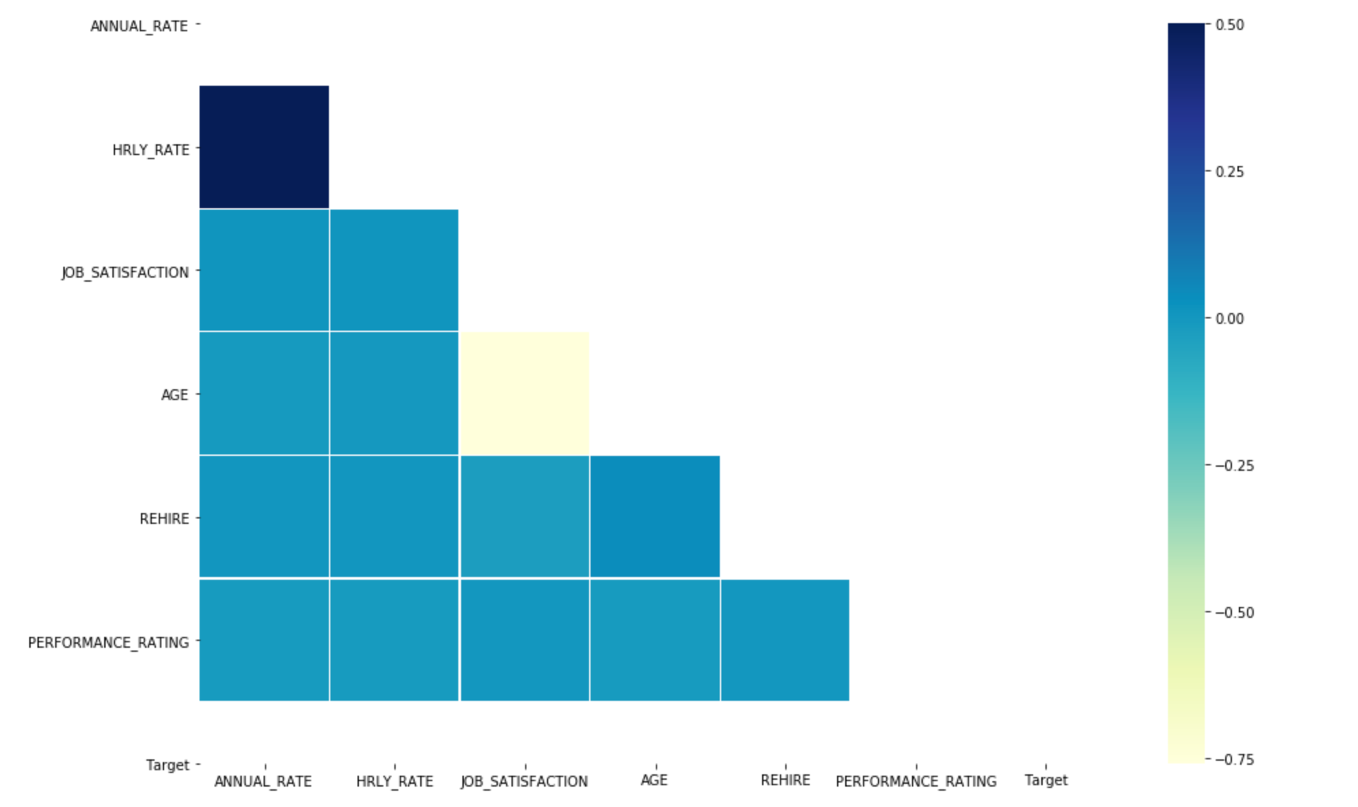


Slide 10
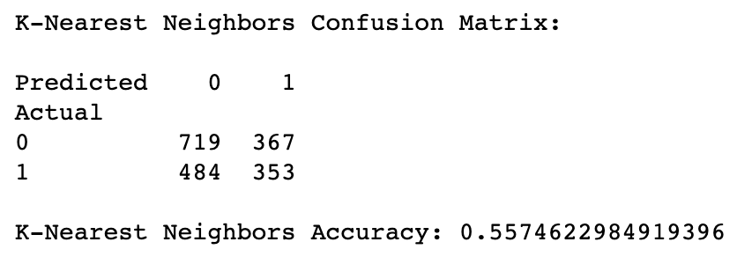
K - NEAREST NEIGHBORS
It is the simplest algorithm for classification.
It computes the majority votes from the samples.
Parameter K is odd and is selected after testing the accuracies.

Slide 11
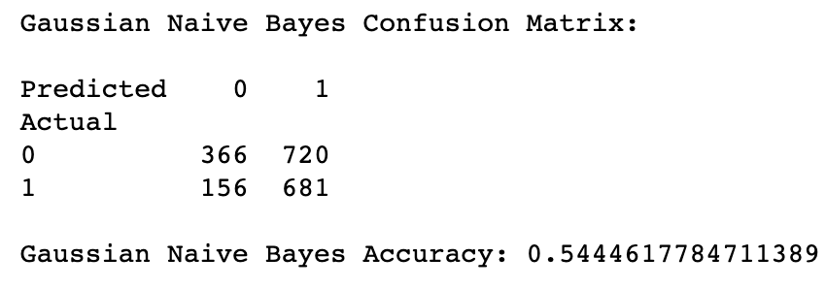
GAUSSIAN NAIVE BAYES
The probability is computed for each class, therefore it is also called as probabilistic model.
The class with the largest probability is selected.
Posterior is calculated using the prior knowledge and maximum likelihood is estimated.

Slide 12
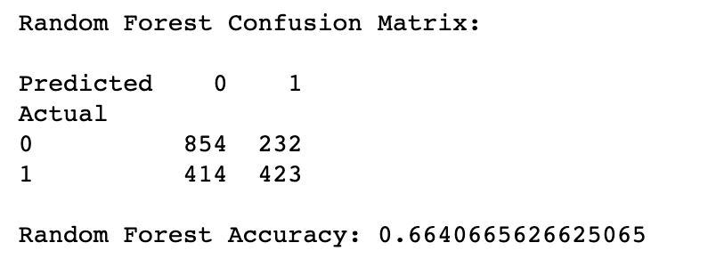
RANDOM FOREST CLASSIFIER
Collection of the unpruned CARTs, there is a rule to combine individual tree decisions.
Randomness is invoked using Bagging and Random Decision Tree.
The final goal is to improve decision tree accuracy

Slide 13
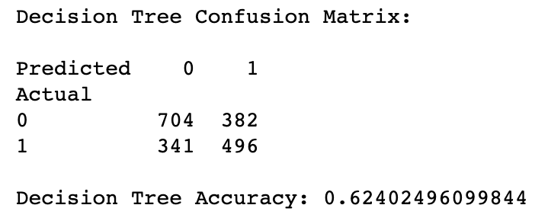
DECISION TREE CLASSIFIER
A <- Best decision attribute for a node.
Assign A as decision attribute for node.
For each value of A, create new descendent node of N.

Slide 14
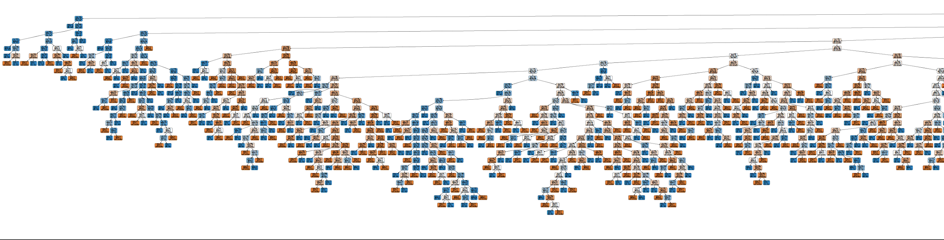
DECISION TREE CLASSIFIER

Slide 15
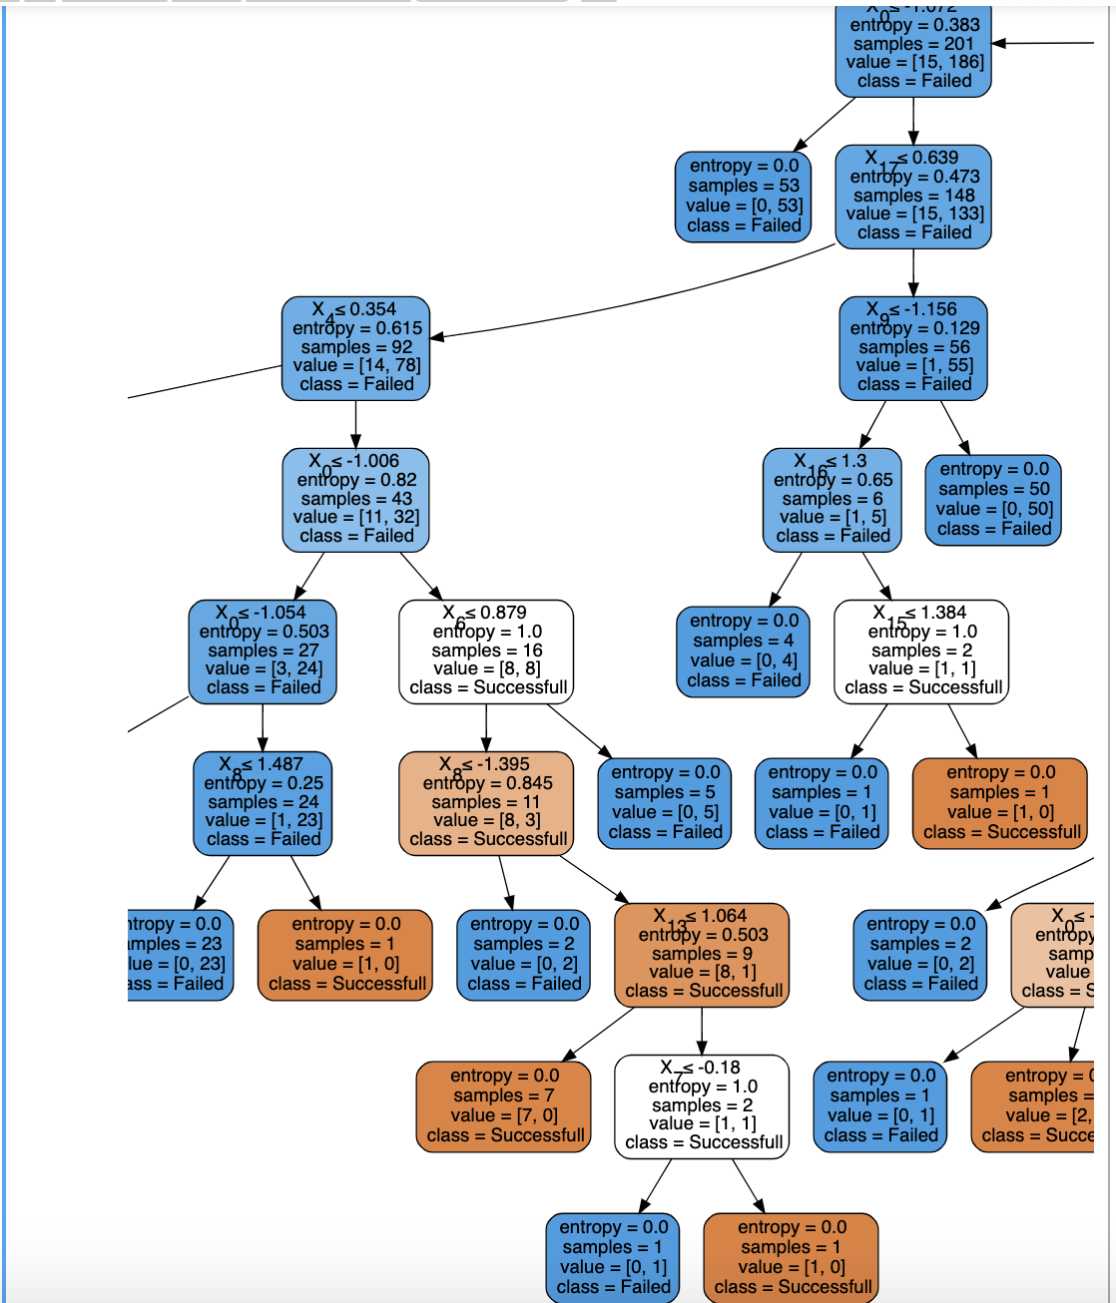

DECISION TREE CLASSIFIER

Slide 16
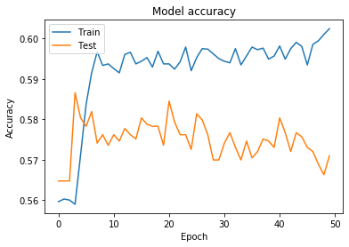
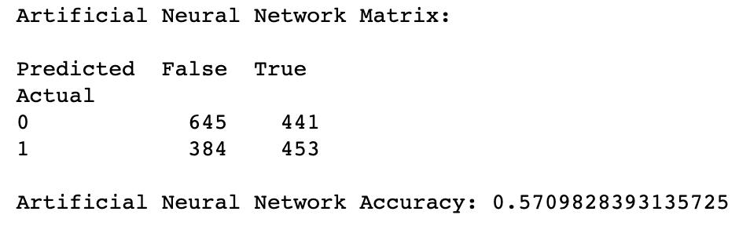
ARTIFICIAL NEURAL NETWORK
Input, Hidden and Output Layer constitutes ANN model.
It works on the concept of weight optimization using Back propagation.
1
As shown in the graph, there is overfitting in the ANN model.

Slide 17
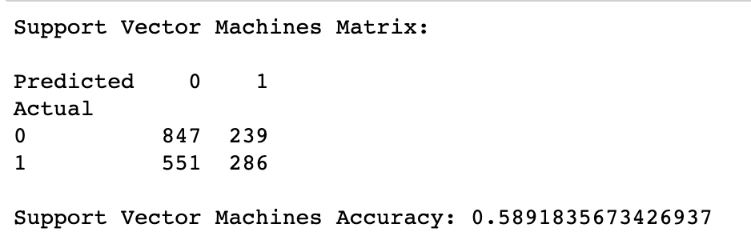
SUPPORT VECTOR MACHINES
The model is very good for binary classification with less features and samples to handle.
The points called support vectors which defines the boundary of the sample dataset.
The hyperplane creates the maximum distance for C=5.

Slide 18
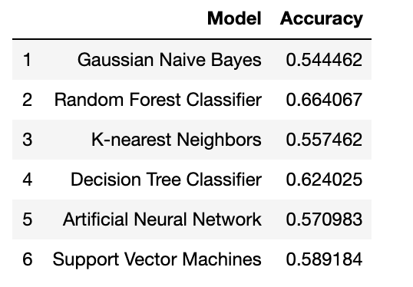
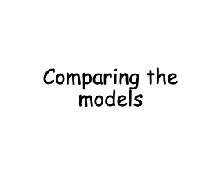
Best accuracy is achieved using Random Forest Classifier.

Slide 19

In the comparison of all the approaches used for testing on the Employee Attrition dataset, The Random Forest, has offered the highest accuracy for the data.
The choice of detection algorithm heavily depends on the dataset itself. The Gaussian Naïve Bayes approach fails to compete with Random Forest and Decision Tree and hence would not a suitable choice for the task.
Apart from all the supervised learning approaches a lot of unsupervised learning algorithms such as the k means clustering and Self-organizing maps can be tested and can prove to be more efficient.

Slide 20

When it Comes to Data, Quality matters more than Quantity!
THANK YOU!

